Slide 1
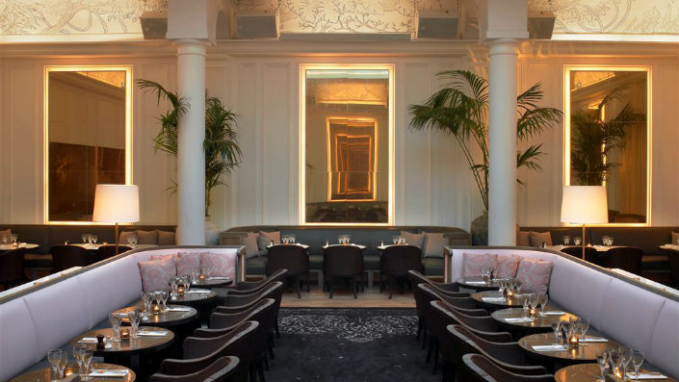
Strategic Business Analysis
Zomato
Restaurant
Analysis
Global Restaurant Expansion Recommendations
Vaibhav Mishra
Data Analytics

Slide 2
The Challenge
01
Problem Statement
Core Objective
Objectives
As a consultant data analyst hired by Zomato, the primary challenge is to develop comprehensive, data-driven strategies and actionable suggestions for opening new restaurants in strategic global markets.
Where to Expand?
Identify countries and cities with low competition and high demand potential
What to Offer?
Strategic Imperative
The management team seeks expansion opportunities in markets with optimal competition levels, strong customer demand, and significant profitability potential.
Determine optimal cuisine types and service offerings for each market
How to Price?
Develop country-specific pricing strategies aligned with market expectations
Analytical Foundation
How to Succeed?
This analysis examines 9,551 restaurants across multiple countries to identify high-opportunity markets.
Define service standards and quality benchmarks for market entry

Slide 3
02
Data Overview
Restaurant ID: Unique identifier for each restaurant.
Restaurant Name: The name of the restaurant.
Country Code: Country code of the location where the restaurant is situated.
City: The city where the restaurant is located.
Address: The specific address of the restaurant.
Locality: The locality or neighborhood where the restaurant is situated.
Locality Verbose: Detailed information about the locality.
Longitude: The geographical longitude coordinate of the restaurant.
Latitude: The geographical latitude coordinate of the restaurant.
Cuisines: The type of cuisine offered by the restaurant.
Currency: The currency used for transactions in the restaurant.
Has Table booking: Indicates whether the restaurant has a table booking option (Yes/No).
Has Online delivery: Indicates whether the restaurant offers online delivery (Yes/No).
Is delivering now: Indicates whether the restaurant is currently delivering (Yes/No).
Switch to order menu: Indicates whether users can switch to the order menu (Yes/No).
Price range: A numeric value indicating the price range category of the restaurant.
Votes: The number of votes or ratings/(feedback) received by the restaurant.
Average Cost for two: The average cost for two people dining at the restaurant.
Rating: The overall rating of the restaurant is based on user reviews.
Date-key opening: The date when the restaurant was opened.

Slide 4
Data Preparation
03
Data Cleaning Process
1
Duplicate Removal
2
Currency Standardization
Applied the "Remove Duplicates" function to ensure each restaurant appears only once for accurate analysis.
Edited currency formats for consistency—converted $ to (USD, AUD, CAD), Rs. to INR, and other currencies to standardized notation for accurate financial analysis.
3
Missing Value Treatment
4
Cuisine Data Completion
Applied IF and AVERAGEIF formulas to replace zero cost values with city-wise average costs.
Filled missing cuisine values as "American" for restaurants in the United States, ensuring categorical completeness for cuisine-based market analysis.
5
Custom Price Column Creation
6
Currency Conversion
Built a custom price column by combining currency code and average cost using CONCATENATE, MID, and FIND.
Simplified cost analysis by converting all currencies to INR using LOOKUP with a conversion table for standardized comparison.
Date Formatting: Converted Datekey_Opening values to standardized yyyy-mm-dd format for temporal trend analysis and year-wise comparisons.

Slide 5
Approach
04
Methodology
Analytical Framework
Our comprehensive analysis followed a structured approach combining data cleaning, enrichment, and multi-dimensional statistical analysis to derive actionable expansion insights.
Data Cleaning
Segmentation
Removed duplicates, standardized formats, treated missing values
Categorized by country, city, price range, rating brackets
Data Enrichment
Competitive Analysis
Added country names, converted currencies, created custom metrics
Identified low-competition markets with growth potential
Statistical Analysis
Strategic Recommendations
Applied aggregation functions, correlation analysis, trend identification
Synthesized findings into actionable expansion strategies
Pivot Tables
XLOOKUP Function
Aggregation
Created pivot tables for country-, city-, and year-wise restaurant distribution to quickly identify market saturation levels..
Used XLOOKUP to map country codes to country names
Applied COUNTIFS, AVERAGEIF, and SUM functions for multi-criteria analysis including price range distributions and rating calculations.

Slide 6
Tools & Functions
04
Methodology
Key Excel Functions Used
Conditional Formatting
Applied conditional formatting to highlight restaurants in recommended cities using:
COUNTA
Counted total attributes in dataset
=ISNUMBER(MATCH(E2, $X$28:$X$34, 0))
=COUNTA(Table1[#Headers]) → 22 attributes
Light ice blue highlighting for visual identification
COUNTIFS
String Operations
=COUNTIFS(Country,"India", Price-range,"=4")
Used CONCATENATE, MID, and FIND functions to create customized price columns combining currency symbols with cost values for enhanced readability.
AVERAGEIF & IF
Calculated conditional averages for ratings
=AVERAGE(IF((Q:Q<4)*(N:N="Yes"),U:U))
Currency Conversion
Array Formulas
Created currency conversion table and applied LOOKUP functions to standardize all costs to INR for comparative analysis across markets.
{=SUM((N:N="No")*(Q:Q=1)*(T:T<=250))}
Visualization Strategy
Created comprehensive pivot charts and dashboards to visualize restaurant distribution, rating patterns, pricing trends, and market opportunities for stakeholder presentations.

Slide 7
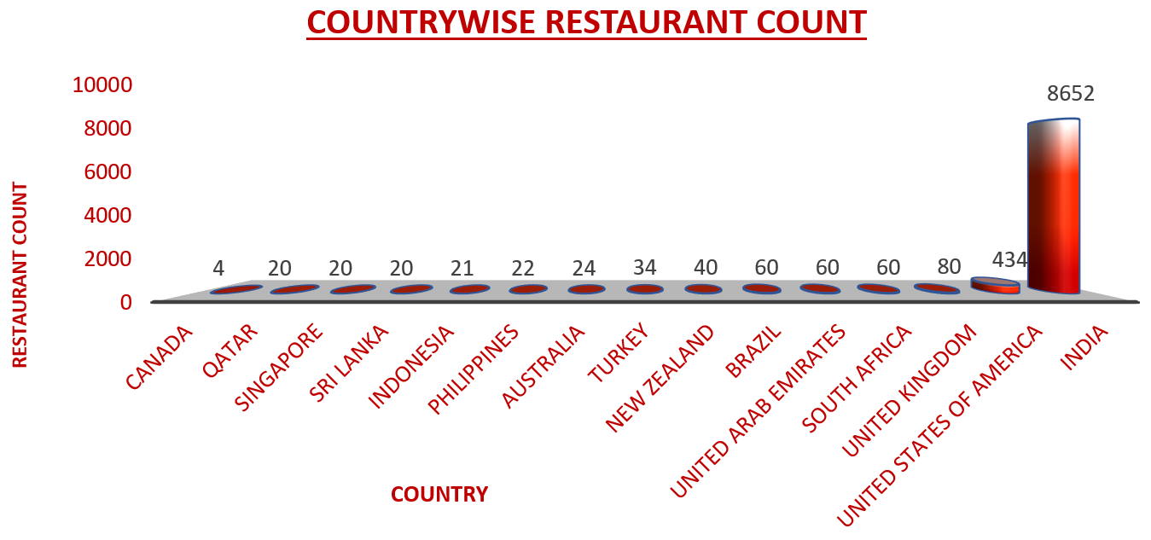
05
Global Restaurant Distribution
Market Concentration Analysis
India
Dominates with total 8654 restaurants.
United States
Secondary market with 434 restaurants.
Canada
Has lowest number of restaurants opened - 4.
Other Countries
Rest of 459 restaurants are fragmented across 12 countries.
Low-Competition Markets
Markets with low restaurant density (≤30) offer first-mover advantages, enabling rapid brand establishment and market share capture before competition intensifies.

Slide 8
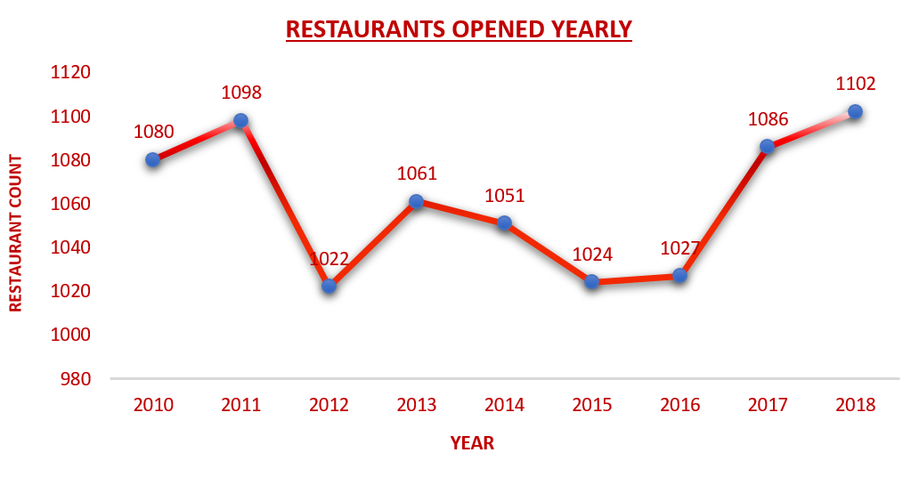
06
Year-Wise Restaurant Openings
Key Observations
Market Growth Trends (2010-2018)
Peak Growth Period
2015-2017 saw highest restaurant openings, indicating market expansion phase
Market Saturation
Decline post-2017 suggests approaching saturation in mature markets
Geographic Expansion
New markets showing consistent growth, indicating expansion opportunities
Growth Pattern
2010-2013
2014-2017
2018
Steady Growth
Rapid Expansion
Market Maturity

Slide 9
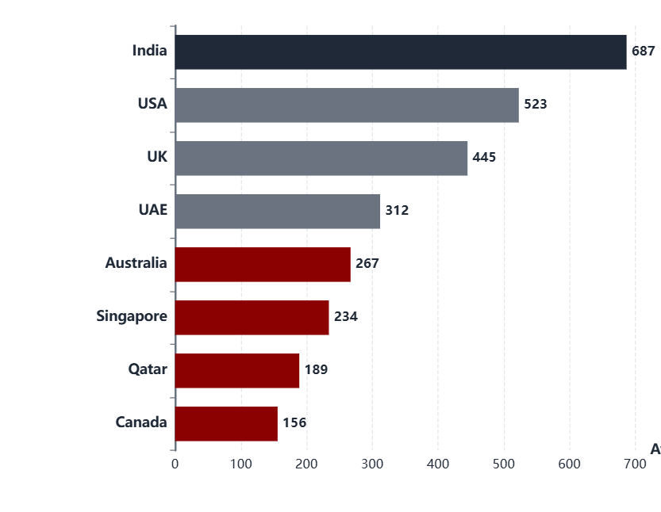
07
Customer Engagement Analysis
Average Votes by Country
Engagement Insights
High Engagement Markets
India and USA show highest vote counts, indicating active customer participation
Emerging Markets
Australia, Qatar, and Canada show moderate engagement with growth potential
Quality Indicator
Higher votes correlate with market maturity and customer engagement levels
Strategic Implication
Markets with moderate votes but low competition present opportunity for engagement growth through quality service and customer experience initiatives.

Slide 10
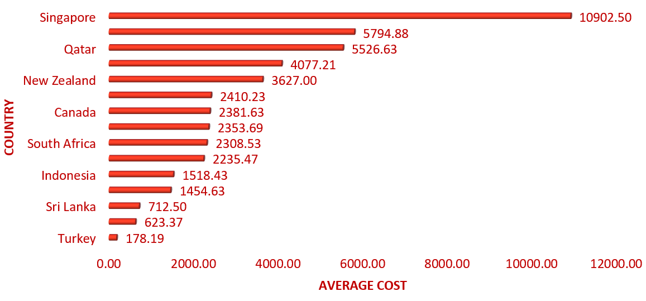
08
Pricing Analysis
Average Cost for Two (INR) by Country
Market Segmentation
Premium Markets
Singapore (10,902), Qatar (₹5,527), UK (₹5,795)
High spending capacity, luxury positioning
Mid-Range Markets
Canada (₹2,382), USA (₹2,354),
Balanced affordability and quality
Value Markets
India (₹1,234), Australia (₹1,455),
Price-sensitive, volume-driven
Key Insight
Currency conversion to INR enables standardized cost comparison across markets, revealing significant pricing disparities.

Slide 11
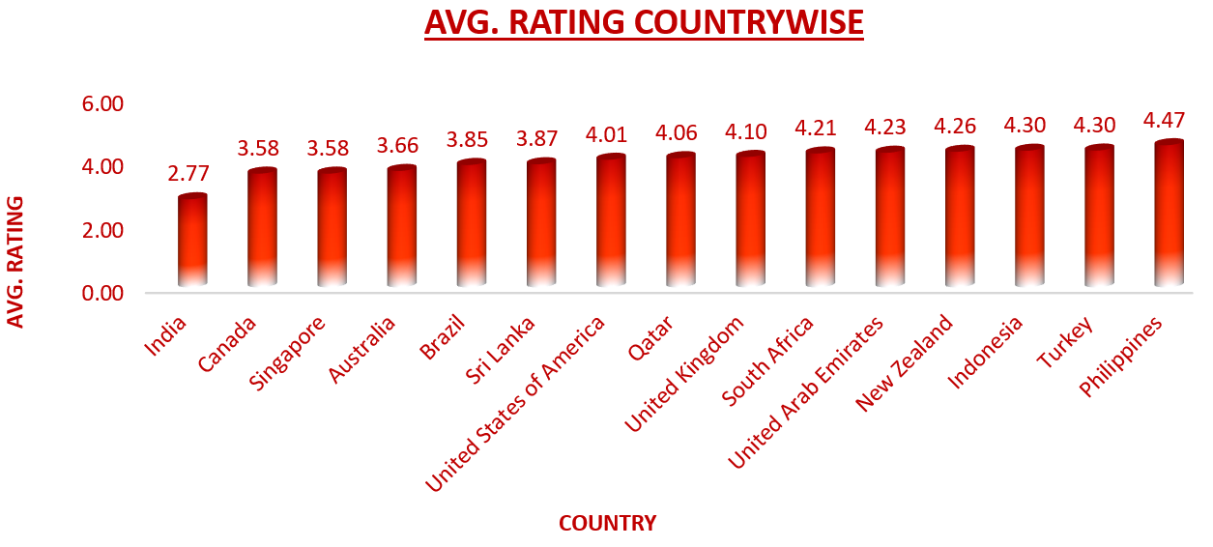
09
Customer Satisfaction
Rating Analysis
Rating Distribution Across Countries
Low-Quality Market
India has lowest average ratings, since it has large no. of restaurants it leads to saturation.
High-Quality Markets
Philippines (4.47 avg), Turkey (4.30), Indonesia (4.30) show strong service quality
Growth Opportunity
Australia, Canada, Singapore, Brazil And Sri Lanka offer room for quality differentiation
Rating Brackets
Majority of the restaurants cluster in 4-5 range, indicating above standard service levels
Strategic Opportunity
Low-rating, low-competition countries offer strong entry opportunities. Better quality and service can help capture these markets quickly.

Slide 12
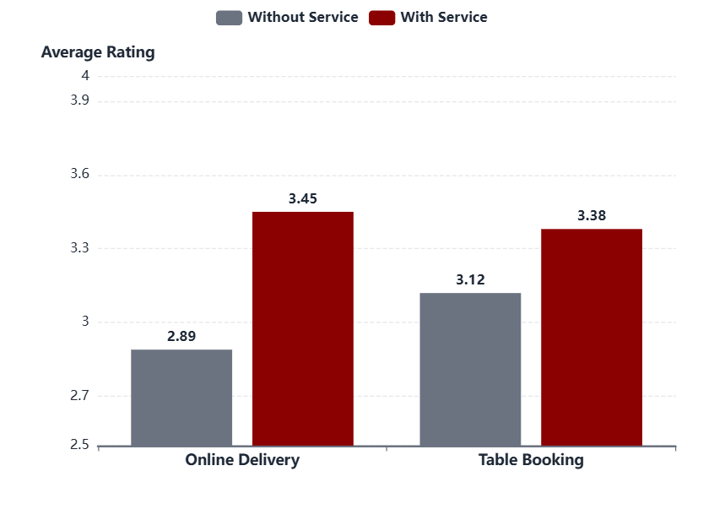
Service Analysis
10
Service Offerings Impact
Impact on Restaurant Ratings
Online Delivery
Rating Impact
Restaurants with online delivery consistently achieve higher ratings than those without
Market Variation
Impact stronger in Canada and Qatar where customers value convenience
Customer Expectation
Online delivery has become a hygiene factor in urban markets
Table Booking
Table booking availability shows positive uplift in ratings, particularly in premium markets and metro cities.
Recommendation: Enable for all new outlets

Slide 13
11
Market Selection: Countries
Recommended Markets for Expansion
Based on multi-criteria analysis of competition levels, customer ratings, engagement metrics, and pricing data, we recommend prioritizing three strategic markets:
Australia
Qatar
Canada
Oceania Market
Middle Eastern Market
North American Market
Restaurant Count
24
Restaurant Count
20
Restaurant Count
4
Avg Rating
3.66
Avg Rating
4.06
Avg Rating
3.58
Avg Cost (INR)
₹1,455
Avg Cost (INR)
₹5,527
Avg Cost (INR)
₹2,382
Market Position
Mid-Range
Market Position
Premium
Market Position
Emerging
Strategic Rationale
These markets offer optimal balance of low competition (≤30 restaurants each), healthy demand indicators (moderate to high ratings), and profitable pricing environments. Early entry enables rapid brand establishment and market share capture before competition intensifies.

Slide 14
12
City-Level Opportunity Analysis
Priority Cities for Market Entry
Drilling down into specific cities within recommended countries reveals high-opportunity micro-markets with limited competition but acceptable customer engagement:
Australia
Canada
Qatar
Balingup
Consort
Doha
Limited competition, manageable pricing
Underserved market with stable response
Strong demand and rating consistency
Mayfield
Yorkton
Market Advantages:
Underserved market potential
Regional hub potential
• Premium spending capacity
Montville
• Quality-conscious consumers
Market Characteristic:
Very low restaurant density creates first-mover advantage opportunity
• Growing expat population
Paynesville
• Limited quality competition
Entry Strategy: Begin expansion in cities with low restaurant counts for higher visibility. Target cities with lower existing ratings first to capture market by offering superior quality and service. Use these as pilot markets before expanding to nearby regions.

Slide 15
15
Cuisine Strategy & Recommendations
Cuisine Performance Analysis
Analysis of cuisine ratings and costs across target cities reveals optimal menu strategies for each market. Cuisine choice significantly affects customer ratings and profitability.
Australia
Canada
Qatar
Modern Australian
Asian Cuisine
Chinese (4.9★, ₹6,175)
Rating:
2.9
Rating:
3.3
Italian (4.5★, ₹9,880)
Cost (INR):
₹4,228
Cost (INR):
₹1,643
Indian (4.18★, ₹4,149)
Aligns with local preferences and commands premium pricing in mid-range market
High rating at affordable cost offers strong value proposition for market entry
Thai (4.3★, ₹10,992)
High-Performance Cuisine Categories
Asian, Japanese, Seafood, and Fusion cuisines consistently achieve higher ratings across markets. High ratings are not always linked to higher costs, indicating opportunity for value positioning. Avoid overcrowded low-differentiation categories unless uniquely positioned.

Slide 16
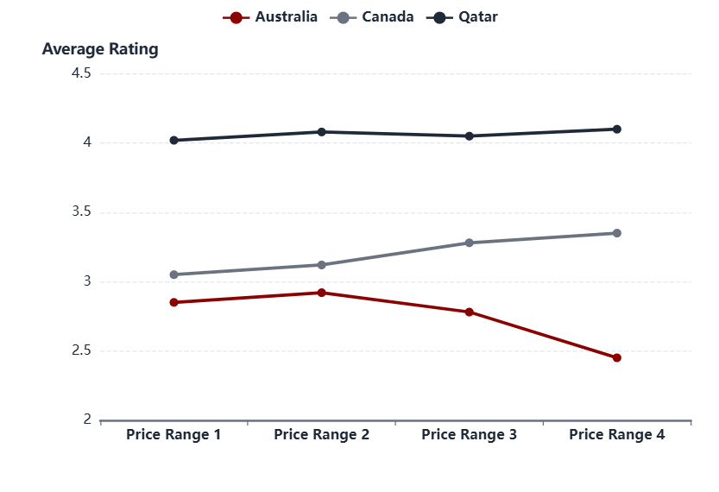
17
Pricing Strategy & Price-Quality Correlation
Price Range vs. Rating Correlation
Key Findings
Weak Correlation
Overall correlation between price and rating is weak—higher prices don't guarantee better feedback
Country Variations
Australia shows price sensitivity; Canada shows willingness to pay for quality; Qatar maintains stability
Value Perception
Customers value experience, consistency, and service more than pricing alone
Strategic Insight
Focus on delivering strong value at mid-price points rather than pushing premium pricing for higher ratings.

Slide 17
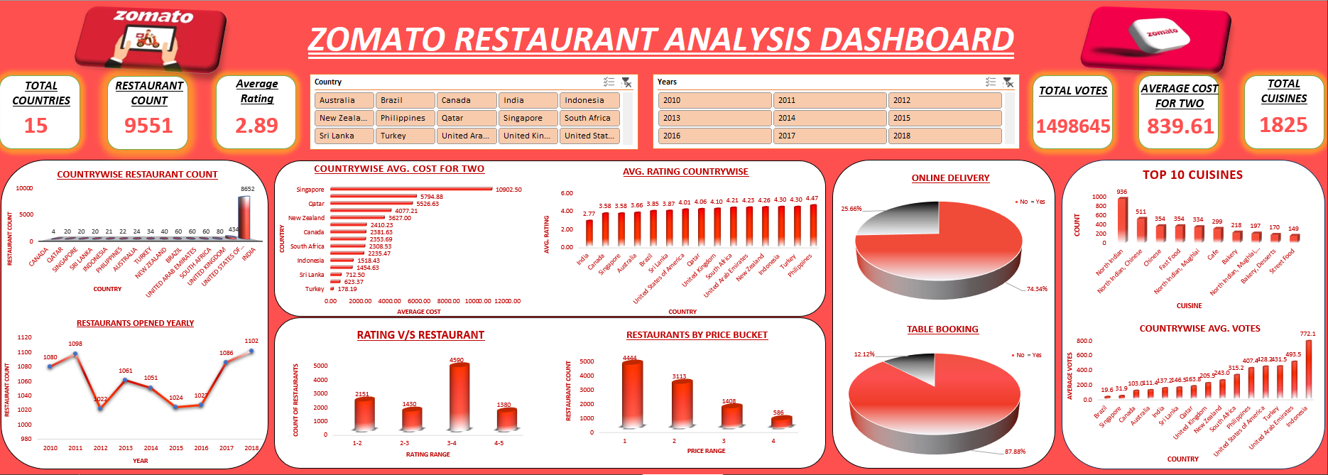
18
Dashboard

Slide 18

Conclusion
18
Australia, Canada and Qatar emerge as the most promising markets, combining high customer ratings, strong engagement, and significant room for expansion.
Within these countries : Balingup, Mayfield, Montville, Paynesville (Australia); Consort, Yorkton (Canada); Doha (Qatar) should be target.
Country Specific Pricing : premium in Qatar (₹5,527 avg), mid-range in Australia (₹2,869), flexible in Canada (₹2,382) aligned with market expectations.
Introducing or strengthening table booking and online delivery services will help improve accessibility and ratings.
Concentrating on cuisines with stable, high ratings and substantial vote counts can accelerate acceptance in new locations.
Acting early in these identified markets will maximize visibility, secure market share, and set a foundation for long-term growth.

